Slide 1
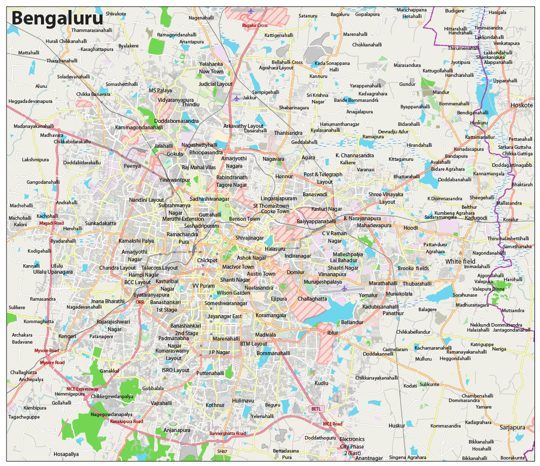
Centre for Cloud Computing and Big Data
Assignment Evaluation
Greenest Part
Team 14:
Dhruva Kashyap: PES1201801457
Rakshith C: PES1201801903
K Vikas Gowda: PES1201801957
S Nikhil Ram: PES1201801972

Slide 2
Obtaining Satellite Images
We wanted to divide bangalore into various areas based on Legislative Constituencies.
We created a Google Earth project and bifurcated each constituency into 1 or more rectangular images.
Link https://earth.google.com/web/data=MicKJQojCiExeXpSMHMyN0JkdEdFNEUtTnp3RVZyU1lQZWNkcGpwY3M6AwoBMA?authuser=0
We created a JSON file where each “Constituency Area” consisted a list of tuples,where each tuple consists of the image name and its physical area(km2).
Link https://drive.google.com/open?id=1vo_H-Dk-tuqg9KhR6mHsKliR9YVjlHAO
Notes:
We interpreted the question to be asking for named regions/localities rather than a grid and coordinates.
Hence, we choose to manually obtain the images by taking screenshots as this would be tedious to automate.
Screenshots of the localities were taken after meticulously mapping the region by hand on the google earth project.
We could have used the google API to obtain images but some of them required billing for the requests or could not provide what we needed.
Other API’s were not considered because of legal and security concerns.

Slide 3
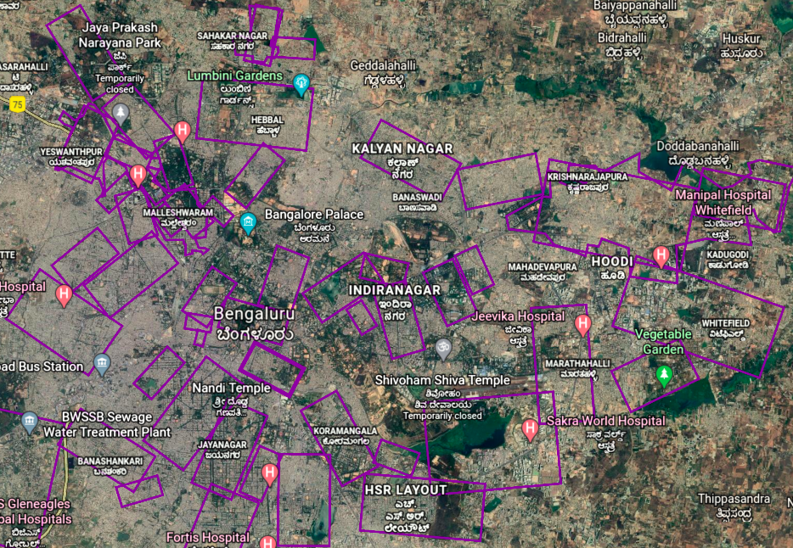
Overview of the google project

Slide 4
Generating Input File:-
We created a python code which takes the maps.json file as input and generates an file which can be taken as input by the map-reduce program.
The format of the input file is as follows -
Each line indicates details about each image
“Constituency”-”physical area”-”image_name.png”
Inputer.py :- https://drive.google.com/open?id=1fC3BJbcynOhe_gif3HUCCzoF8t3VMYHL

Slide 5
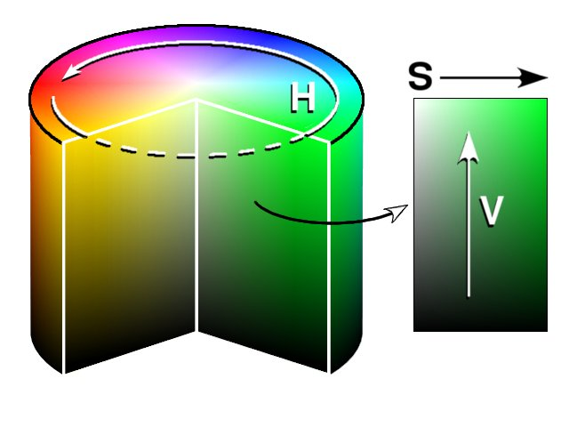
Image Processing using OpenCV
We have used python OpenCV 3.2.0 as the tool for image processing.
The image processing task has been run by the mapper of the hadoop job
grids
Parallelizable
HSV

Slide 6
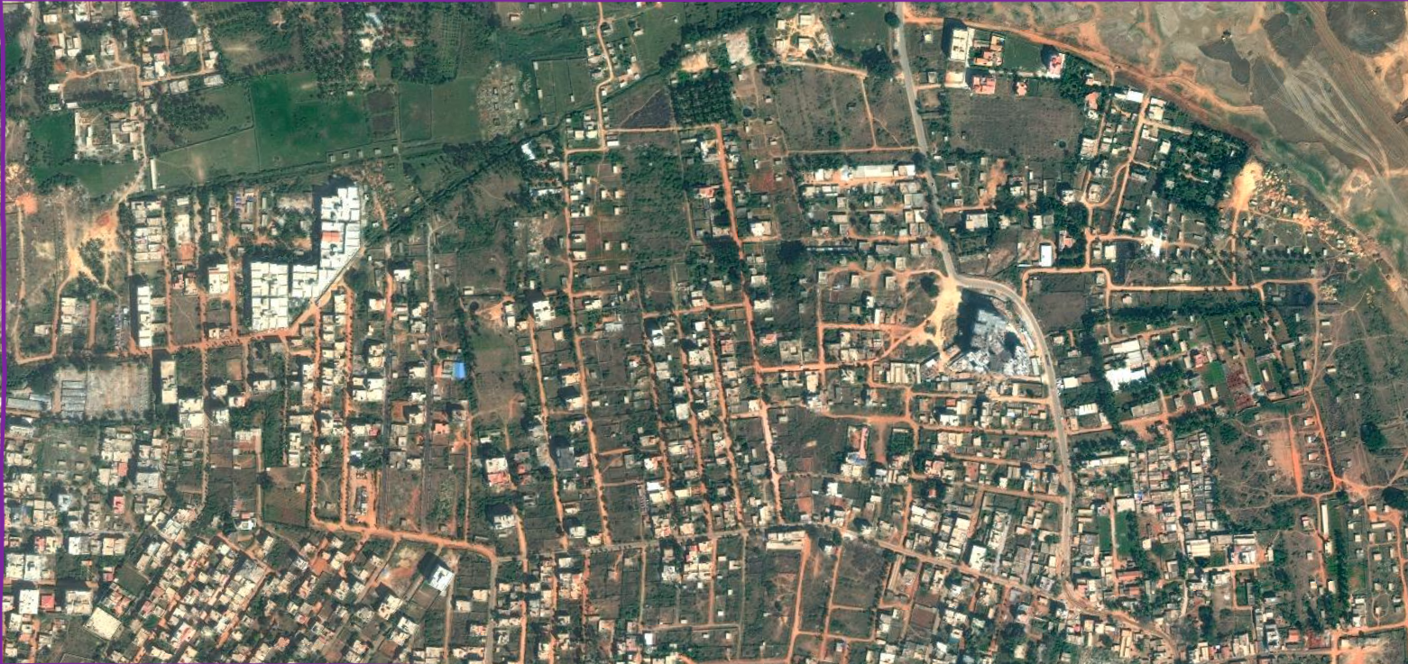
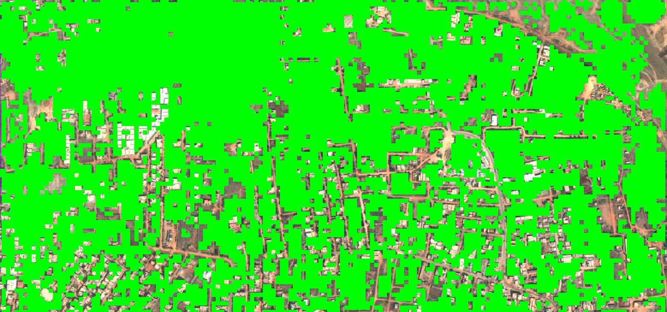
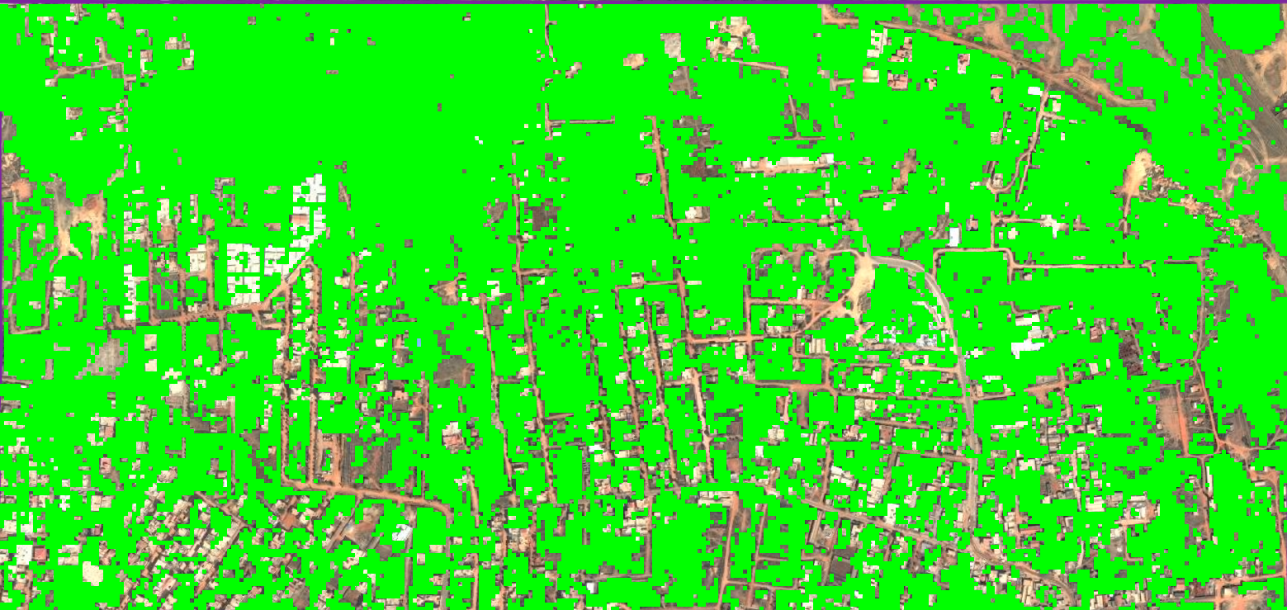
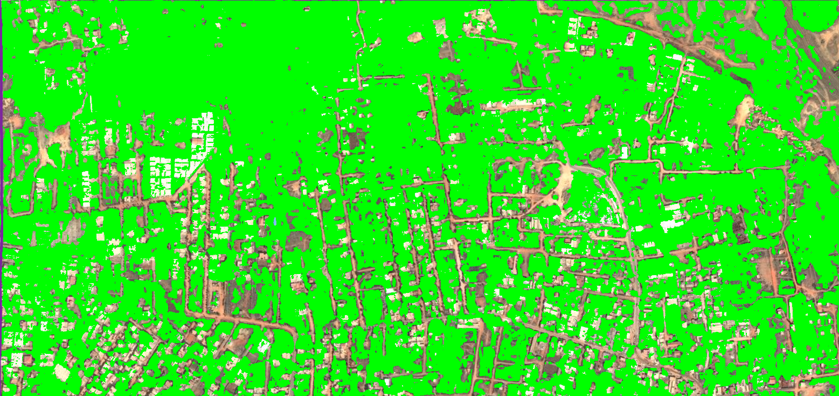
Original image
Grid size-10x10 px
Grid size-5x5 px
Grid size-1x1 px

Slide 7
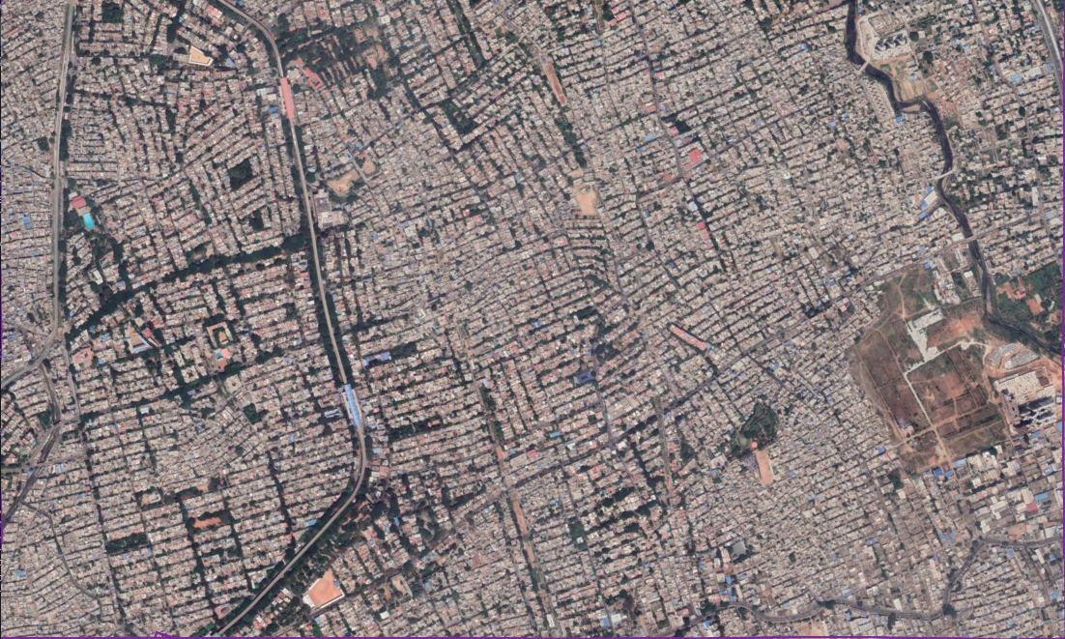
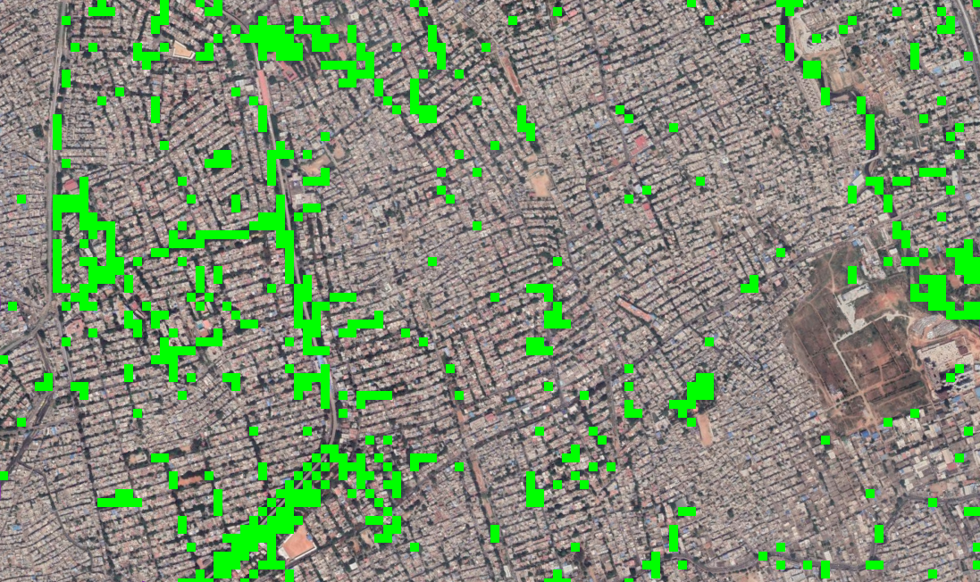
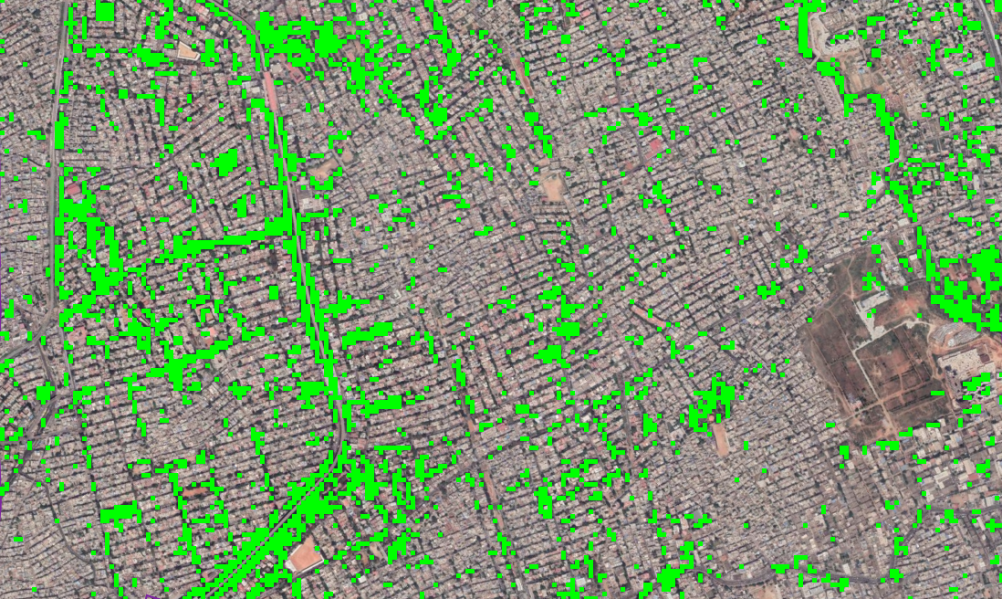
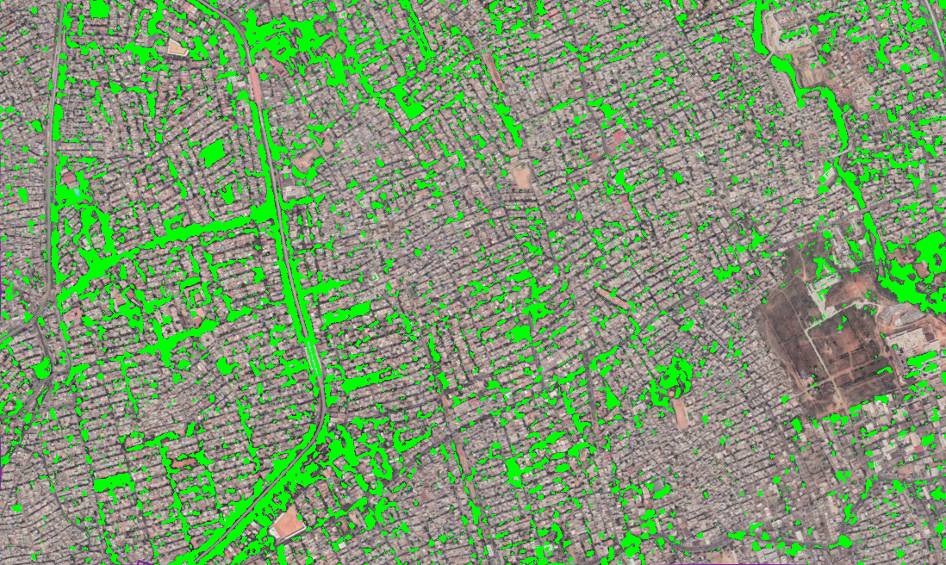
Original image
Grid size-10x10 px
Grid size-5x5 px
Grid size-1x1 px

Slide 8
Pseudo-Distributed-Mode Hadoop Setup
Virtual Machine was set up with the following specifications-
Ubuntu 18.04 LTS Operating System
6 GB RAM
Set up hadoop 3.2.1 (latest stable release)
Environment configured to run in pseudo distributed mode
All yarn sites/dfs sites/map reduce etc .xml files configured
Virtual memory limit check disabled
<property>
<name>yarn.nodemanager.vmem-check-enabled</name>
<value>false</value>
</property>

Slide 9
Hadoop Mapper-Combine-Reduce
Python mrjob module used
Mapper-Combiner-Reducer model used
Jobber.py :- https://drive.google.com/open?id=1a8U138z-bHZd_hJjjKVg-GGTpqBuq30l

Slide 10
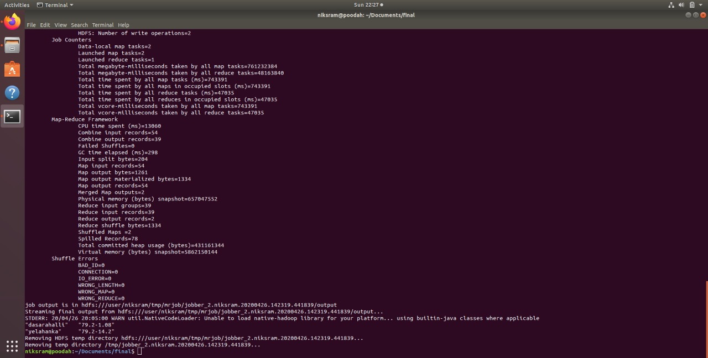
OUTPUT -

